Slide 1
Lecture 06
Probability, Statistics, Uncertainty, and Stochastic Simulations
Part I
Notes:
https://snu-ac-kr.zoom.us/j/84027051484?pwd=aU5OZitOKzUyRW9DQ0s0TkpIMSs4UT09

Slide 2
Review on Previous Lectures
Lec 03-04: Introduction to Conventional Optimization Models
Nonlinear Optimization Models, LP, DP
Lec 05: Data-fitting, Evolutionary Optimization Models
EA: Evolutionary Algorithms (진화 알고리즘)
GA: Genetic Algorithms (유전 알고리즘)
GP/EP: Genetic Programming/Evolutionary Programming (유전 프로그래밍/진화 프로그래밍)
ANN: Artificial Neural Networks (인공 신경망)
DE: Differential Evolutions (차분 진화 알고리즘)
EMODPS: Multi-objective Direct Policy Search (진화적 다목적 직접 정책 검색법)

Slide 3
Today’s Topic: Probability, Statistics, Uncertainty and Stochastic Simulations
Why does Uncertainty (불확실성) occur in WRSA?
Difference in the timing of Design, Building & Operation
Time variability & change (Blöschl et al. 2019)
Stochastic (randomness over time) nature of meteorological and hydrological processes such as rainfall and evaporation
How to deal with Uncertainty?
Simplest approach = Replacing with representative values (대표값)
Mean (expected values), median, worst-case values, etc. …
However, can create a poor representation of both the average performance & the possible performance range
Probability & Statistics

Slide 4
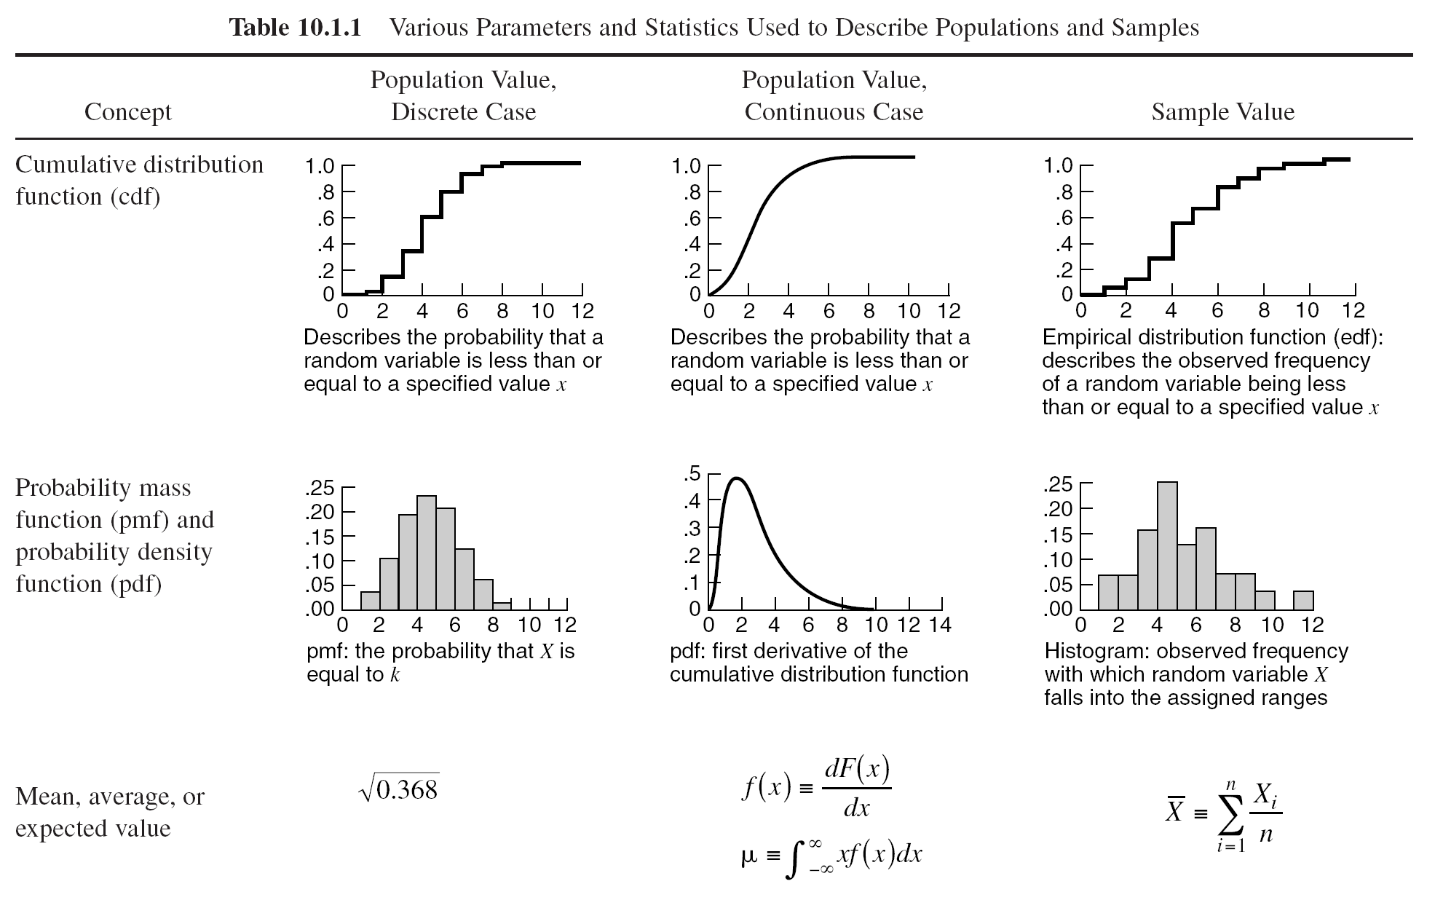
Review on Common Representative Values
Basic Probability Concepts
1) Measures of Central Tendency
Arithmetic Mean (expected values)
Median (중앙값)
=> useful for describing central tendency regardless of skewness (less sensitive to outsiders)
Mode (최빈값)
1,3, 3, 6, 7, 8, 9
Median = 6
1, 2, 3, 4, 5, 6, 8, 9
Median = (4+5) / 2 = 4.5
(Where n is the number of data points)

Slide 5
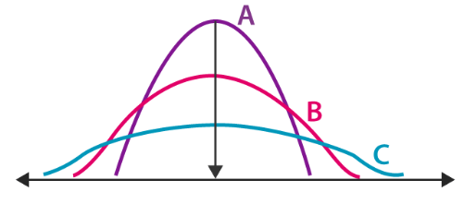
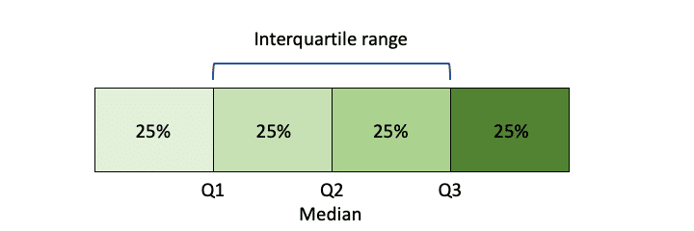
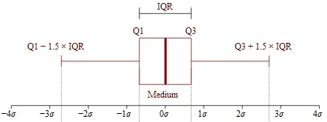

Review on Common Representative Values
Basic Probability Concepts
2) Measures of Dispersion: Describes the spread of data
Examples include:
Range: $X_{max}$ & $X_{min}$ (관측값중 가장 큰 값 & 가장 작은 값)
Quartiles & Interquartile Range
Variance (Standard Deviation)

Slide 6
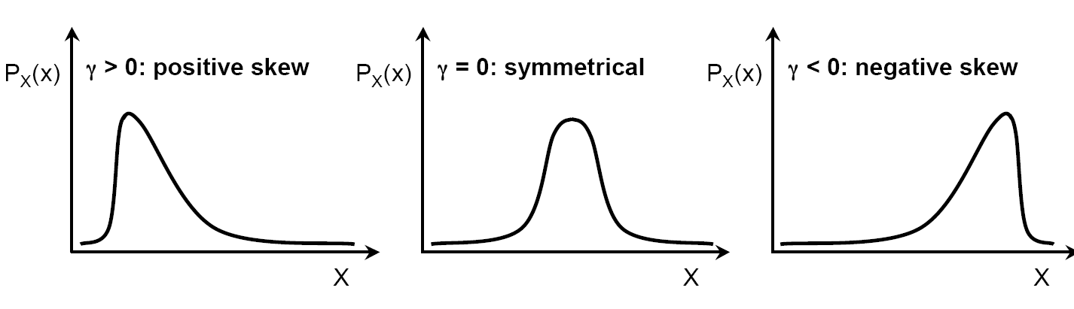
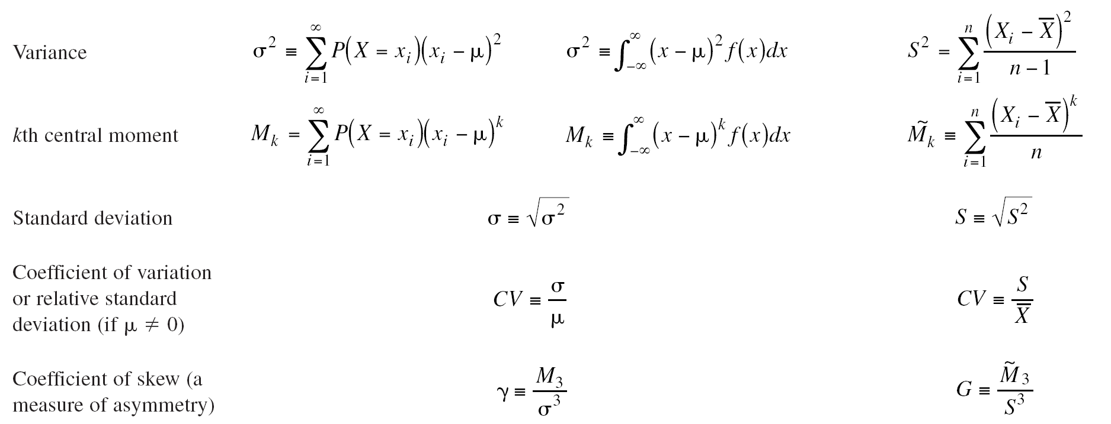
Review on Common Representative Values
Basic Probability Concepts
3) Measure of Asymmetry
Coefficient of Skew
Using the 3rd moment and the standard deviation,
and

Slide 7
Review on Common Representative Values
Basic Probability Concepts (Data observed in Pairs)
4) Measure of Correlation (Relation between two random variables)
Linear Correlation Coefficient
Correl(Rainfall,Runoff) = 0.91

Slide 8
Summary (1)
How to deal with Uncertainty?
Simplest approach = Replacing with representative values (대표값)
Mean (expected values), median, worst-case values, etc. …
However, can create a poor representation of both the average performance & the possible performance range
Common Representative Values for:
Measures of Central Tendency: mean, median, mode
Measures of Dispersion: range, IQR
Measure of Asymmetry: coefficient of skew
Measure of Correlation: linear correlation coefficient

Slide 9
Explain the data with Rep. Values?
No! Proof?
Justin Matejka, George Fitzmaurice (2017). Same Stats, Different Graphs: Generating Datasets with Varied Appearance and Identical Statistics through Simulated Annealing CHI 2017 Conference proceedings: ACM SIGCHI Conference on Human Factors in Computing Systems

Slide 10
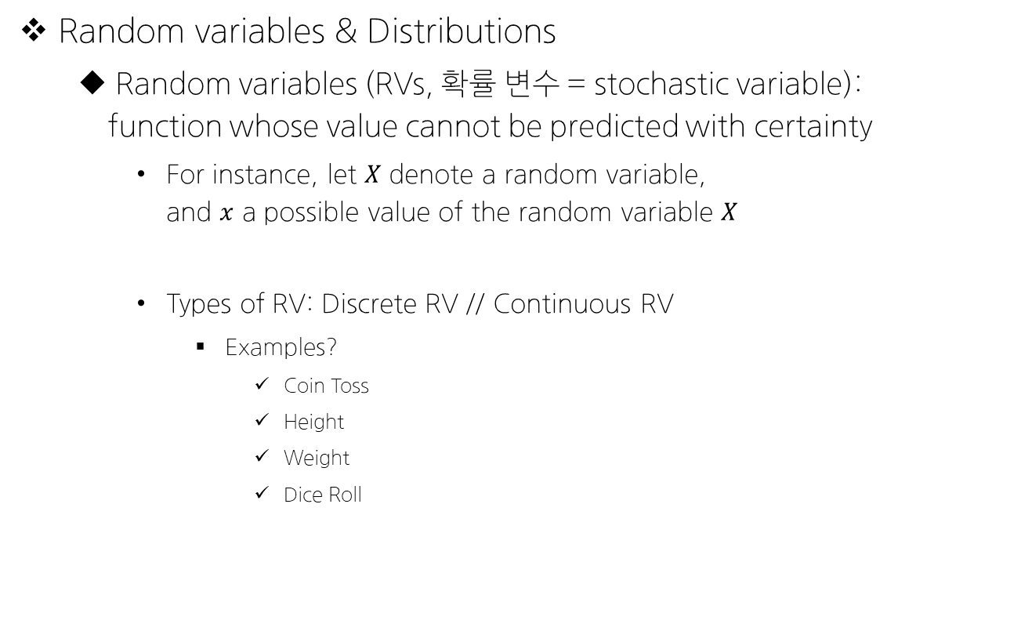
Concept of Probability
Random variables & Distributions
Random variables (RVs, 확률 변수 = stochastic variable): function whose value cannot be predicted with certainty
For instance, let $X$ denote a random variable, and $x$ a possible value of the random variable $X$
Types of RV: Discrete RV // Continuous RV
Examples?
Coin Toss
Height
Weight
Dice Roll

Slide 11

If $X$ is a discrete random variable,

Slide 12

If $X$ is a continuous random variable,

Slide 13

In case of joint probability distribution of $X$ and $Y$,

Slide 14
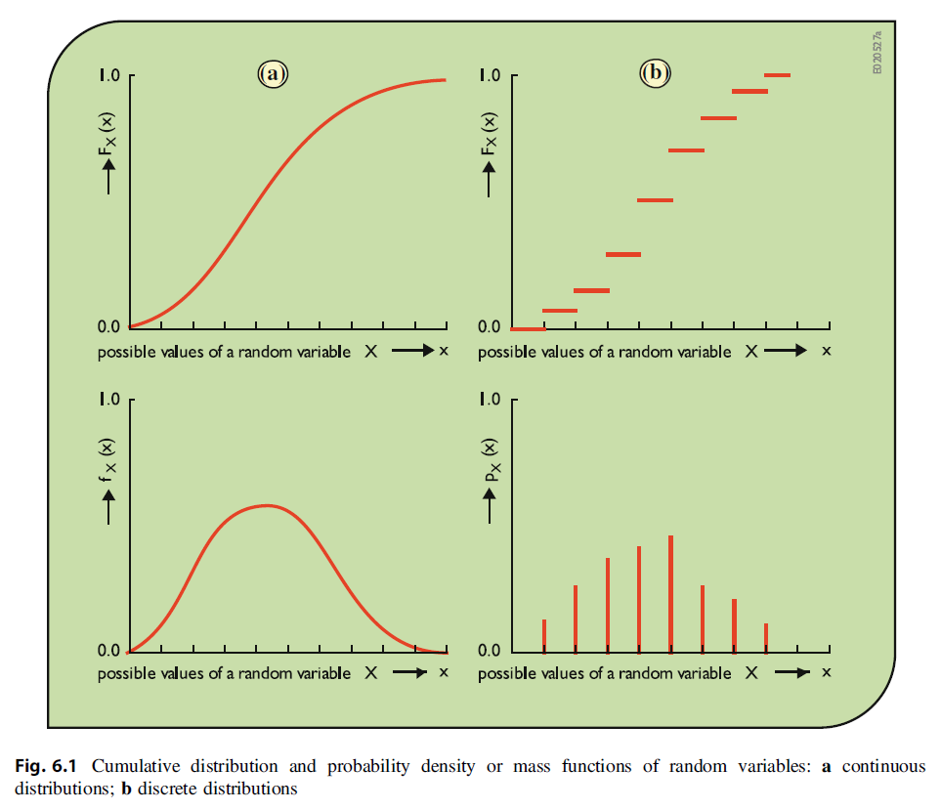
Review on the Probability Concepts
Notes:
1 2
3 4 순서대로 CDF // CDF // PDF // PMF

Slide 15
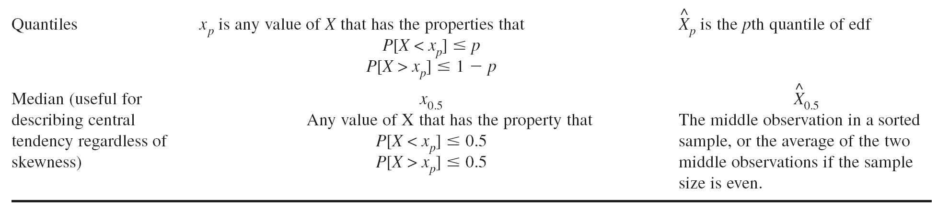
Summary (2)

Slide 16
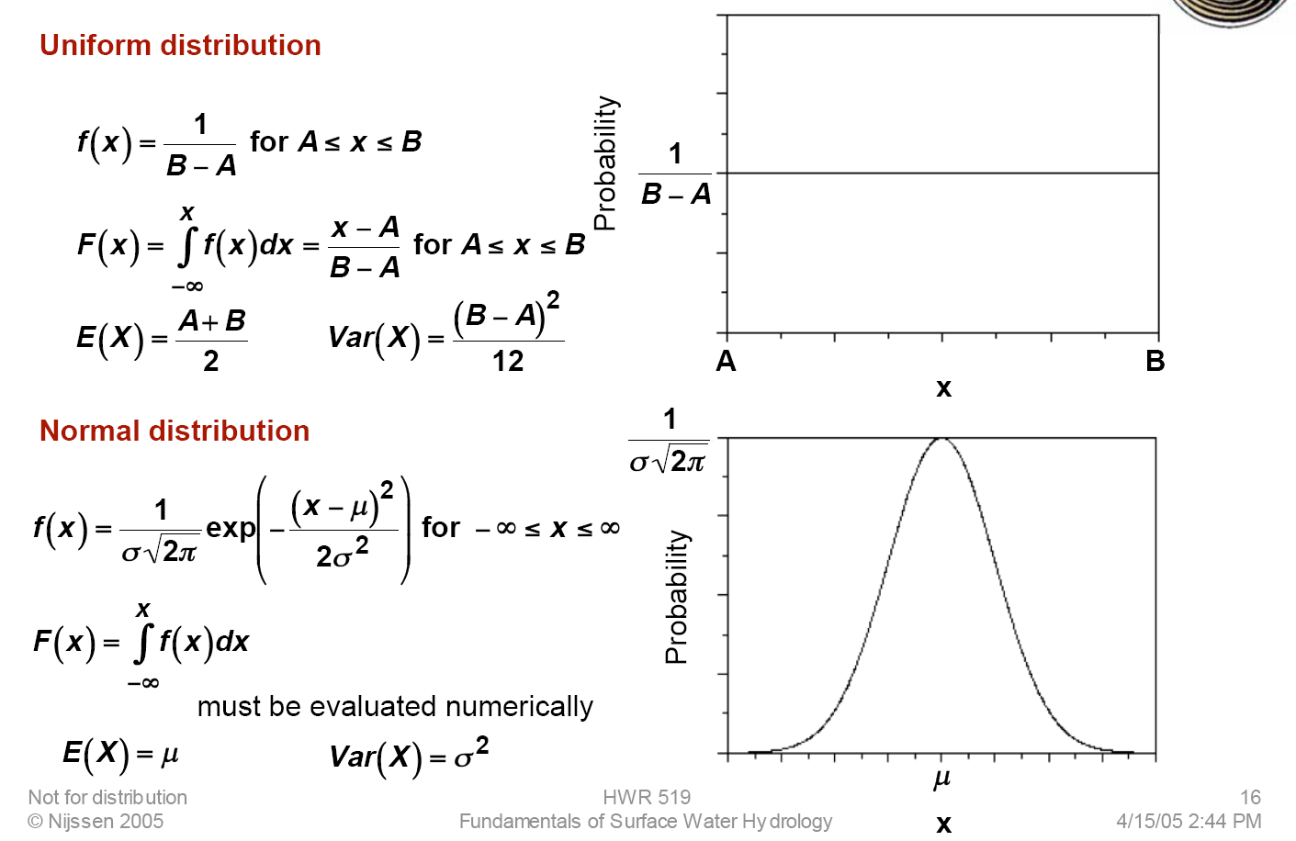
Common Distributions in WRSA

Slide 17
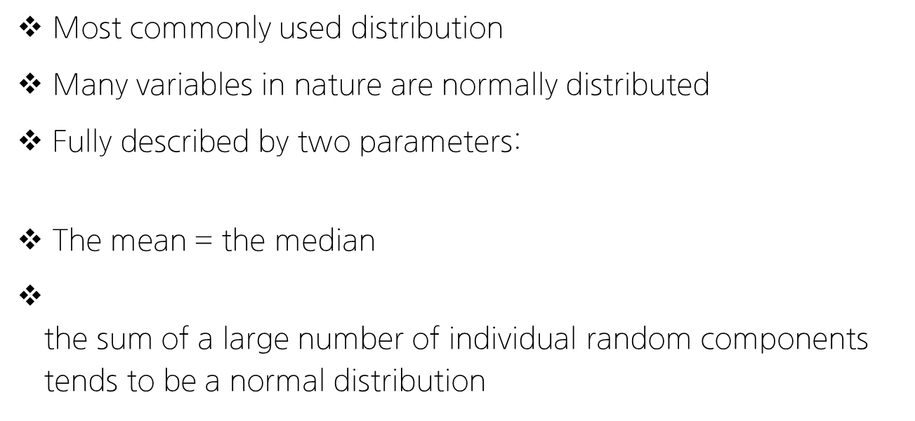

More on the Normal Distribution
$$X\sim N(μ_{X},σ_{X})$$
Most commonly used distribution
Many variables in nature are normally distributed
Fully described by two parameters: mean ($μ_{X}$) and standard deviation ($σ_{X}$)
The mean = the median
Central Limit Theorem (CLT)– the sum of a large number of individual random components tends to be a normal distribution

Slide 18

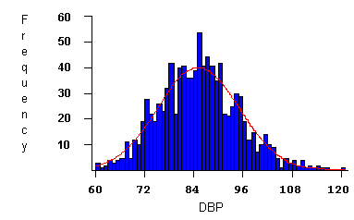
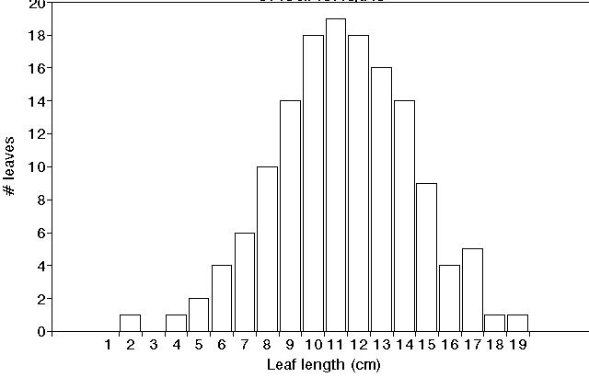
Many random variables in nature follow a normal distribution
Leaf lengths¹
Blood pressure ²
(1000 patients)
¹Oklahoma State University
²SurfStat Australia

Slide 19
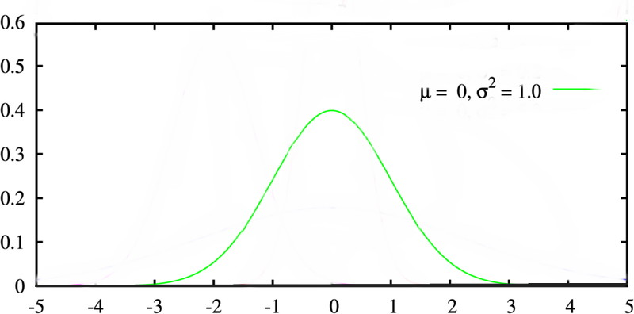
Standard Normal Distribution
A normal distribution with parameters μ = 0 and σ² = 1 is known as the standard normal distribution
Solved numerically and
results widely tabulated
Φ(z_{i}) = F_{Z}(z_{i}) = P(z < z_{i})

Slide 20
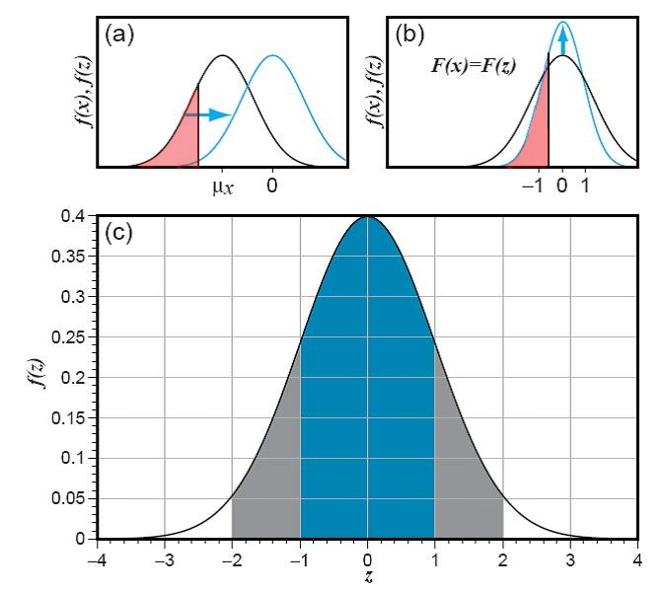
Transforming into Standard Normal Dist.
“Standard Normal Variate”
We use this equation to normalize x – in other words to find the value of z such that
F_{X}(x) = F_{Z}(z)

Slide 21
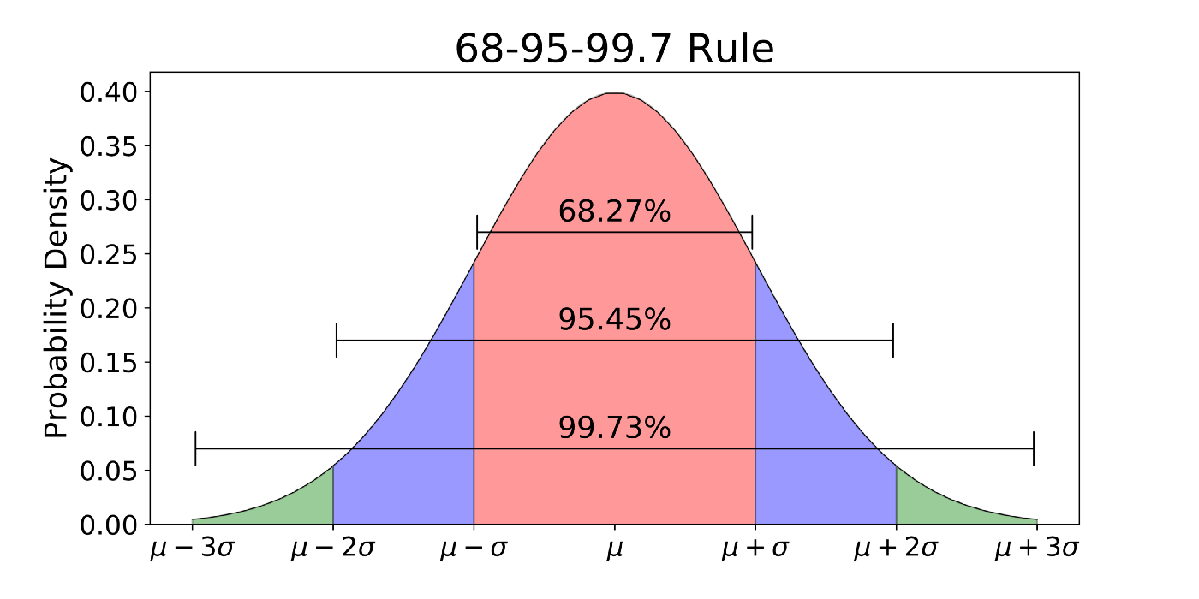
68-95-99.7 rule for a Normal Distribution

Slide 22
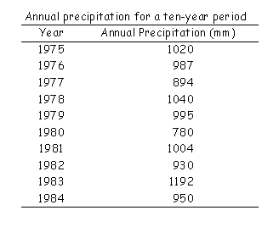
Example Problem: Annual Precipitation
1) Sketch the histogram
2) Calculate μ and σ
3) Assume a normal distribution – is this reasonable?
4) What is the probability that the annual precipitation this year will be greater than 1100 mm?

Slide 23
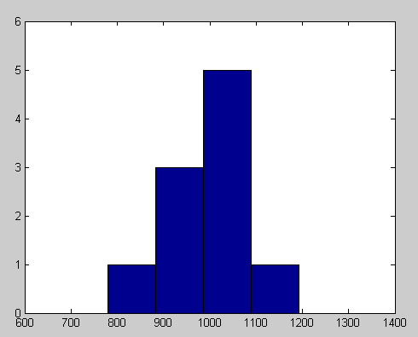
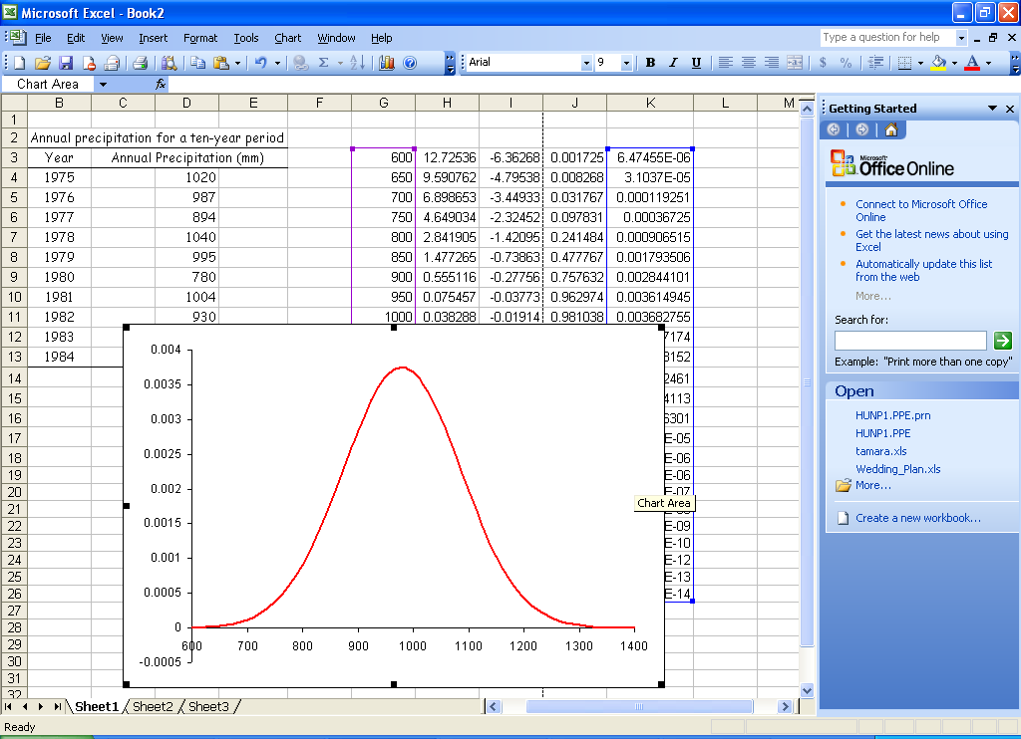
Example Problem: Annual Precipitation
1) Sketch the histogram
2) Calculate μ and σ
3) Assume a normal distribution – is this reasonable?
4) What is the probability that the annual precipitation this year will be greater than 1100 mm?
N(979.2, 106.3)
μ = 979.2 mm σ = 106.3 mm

Slide 24
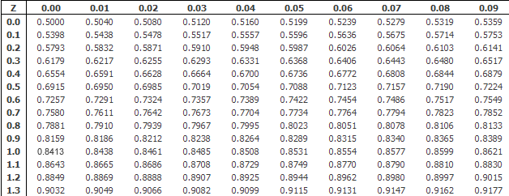
Example Problem: Annual Precipitation
4) What is the probability that the annual precipitation this year will be greater than 1100 mm?

Slide 25
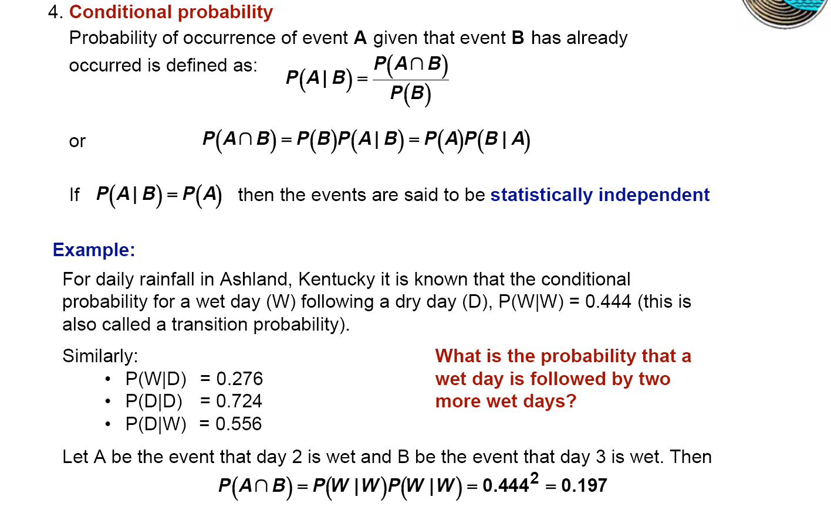
Finally, Conditional Probability P(A|B)

Slide 26
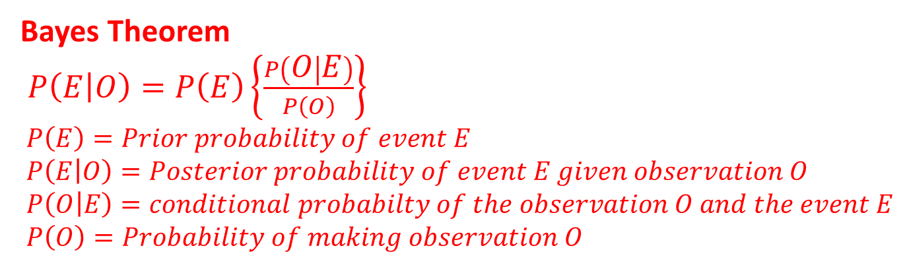
Bayes Theorem
The basics
a priori uncertainty + new information
Yields revised assessment of uncertainty
Multiple observations—use repetitions of Bayes Theorem
Bayes Theorem
$P\left(E | O\right)=P\left(E\right)\left\{\frac{P\left(O | E\right)}{P\left(O\right)}\right\}$
$P\left(E\right)=Prior probability of event E$
$P\left(E | O\right)=Posterior probability of event E given observation O$
$P\left(O | E\right)=conditional probabilty of the observation O and the event E$
$P\left(O\right)=Probability of making observation O$

Slide 27
P(E|O)
Read “probability of event E conditional on O having been observed”
New information in estimate
P(O|E)
Frequency that observation O is associated with existence of specific event E
Ex: probability of observing salt domes when there is oil
P(E|O) ≠ P(O|E) these probabilities are not symmetric!
P(O = male/E = king) = 1.0
P(E = king/ O = male) is probability of finding a king given the observation an individual is male = ~ 10⁻⁹
P(O)
Probability of making a specific observation O considering all ways it can occur
The probability of making observation O may be associated with all possible events E_{i}

Slide 28

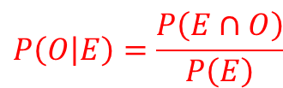




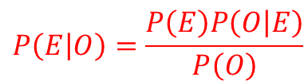


Bayes Theorem: Derivation
$$Ω$$
$$E$$
$$O$$
$$\left(E∩O\right)$$
According to conditional probability,
$$P\left(E | O\right)=\frac{P\left(E∩O\right)}{P\left(O\right)}$$
The fraction of ellipse B that
overlaps with ellipse A
and
$$P\left(O | E\right)=\frac{P\left(E∩O\right)}{P\left(E\right)}$$
The fraction of ellipse A that
overlaps with ellipse B.
Solving for $P\left(A∩B\right)$, the common factor:
$$P\left(E∩O\right)=P\left(E\right)P\left(O | E\right)=P\left(O\right)P\left(E | O\right)$$
Rearranging to give$P\left(A | B\right)$:
$$P\left(E | O\right)=\frac{P\left(E\right)P\left(O | E\right)}{P\left(O\right)}$$
Note: one can reverse E and O
and the solution is still valid

Slide 29
Example Problem: Bayes Theorem
In the United States, approximately 1 in 100 otherwise healthy people has Celiac Disease1. A new diagnostic test, has a 95% reliability, i.e., 95% of people with Celiac test positive, and 95% of people without Celiac test negative. During trials, a randomly selected person tests positive.
(a) What is the probability that the person has Celiac Disease?
(b) What is the probability that the person doesn’t?

Slide 30

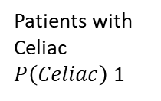
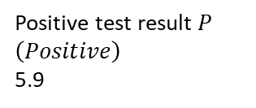
Example Problem: Bayes Theorem
(a)
Population = 100
Positive test result $P\left(Positive\right)$
5.9
Patients with Celiac
$P\left(Celiac\right)$1
$$P\left(Celiac | Positive\right)$$

Slide 31

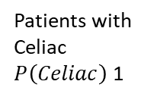
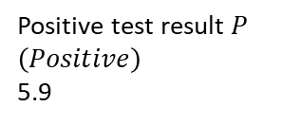
Example Problem: Bayes Theorem
(b)
Population = 100
Positive test result $P\left(Positive\right)$
5.9
Patients with Celiac
$P\left(Celiac\right)$1
$$P\left(Celiac | Positive\right)$$

Slide 32
Tips for the TEST (2022 Spring WRSE)
Closed Book, 150 mins, Calculators allows
Exact Time & Place: May 17 화요일, 17:00-19:30, 35-431
출제 범위
Primary Textbook Chapters
01, 02, 03, 04, 05, 06-(6.2.3, p.223 까지 출제범위)
Lecture Notes: 01, 02, 03, 04, 05, 06
Assignments: #1, #2
Quizzes: #1, #2
Other New Questions (1 Question, 2 Questions Max)

Slide 33
Future Schedule (~End of Course)
May-17 (1): TEST
May-24 (2):
Lec 07: Probability, Statistics, Uncertainty, and Stochastic Simulations
Lec 08: Performance Criteria
May-31 & Jun-07 (3 & 4)
Lec 09: Water Resources Systems Engineering Frontiers-Introduction and Examples Part 1
Lec 10: Water Resources Systems Engineering Frontiers-Introduction and Examples Part 2 (Invited Talk)
Jun-14: Final Project Presentation + Report Due (5)
Report는 추후에 기술기사로 출판할 예정 (6-7월 중)

